Slide 1
Climatic regions of India
By Stamp
By Koppen
By Thorthwaite
By Trewartha
By R.L.Singh

Slide 2
Climatic regions of India by Trewartha
Symbol | significance
A | Tropical Humid climate
B | Dry climate (Rainfall <100 cm)
C | Sub-tropical humid
H | Mountainous climate

Slide 3
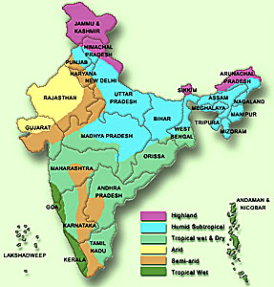
Climatic regions of India by Trewartha
A: tropical Humid
Am = Tropical Rainy monsoon type (>250 cm rainfall)
Western cost, Tripura
Aw = Tropical wet and dry (avg. 100 cm rainfall)
Most of peninsular plateau, Mizoram
Am
Aw
Aw
Am

Slide 4
Climatic regions of India by Trewartha
B: dry climate
Bs = semi-arid (<100 cm)
Rain-shadow region of Western Ghats
Bsh= dry regions (Kathiawar, Rayalseema, Telangana, malawa plteau)
Bwh: desert (Thar, Kutchh)
Bwh
Bsh
Am
Aw
Aw
Am
Bs

Slide 5
Climatic regions of India by Trewartha
C: Sub-tropical
Caw= humid, sub-humid
Northern Plains, most of NE states
Summer rainfall (E->W)
Winter rainfall in NW part
H = mountainous
Himalayan regions
H
Bwh
Bsh
Caw
Am
Aw
Aw
Am
Bs

Slide 6
Vegetation types in India
Tropical forest
Montane forest
Alpine forest

Slide 7
Tropical Forest
Tropical forest
Moist
Wet evergreen
Semi-evergreen
Dry
Moist deciduous

Slide 8
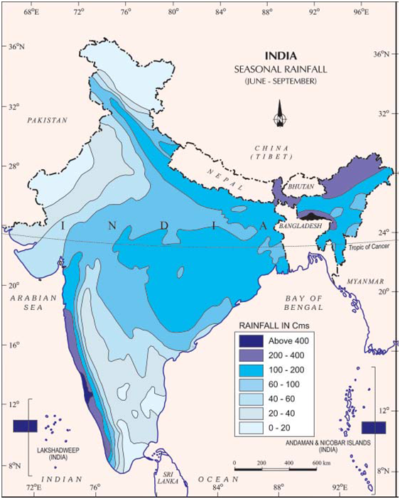
Tropical Wet -Evergreen forest in India
Areas of very high rainfall
More than 250cm
Temperature 25-27 deg
Western side of western Ghats, NE states and Andaman and Nicobar

Slide 9
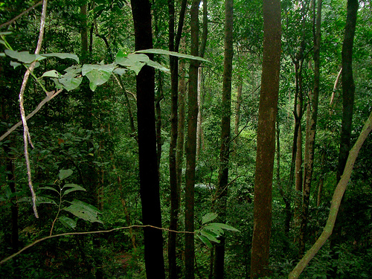
Tropical Wet- Evergreen forest in India
Dense forest + dense undergrowth
Pine, bamboo, Jamun
Underdeveloped lumbering industry:
Tress are not in pure stands
Lack of transport facility

Slide 10
Tropical Semi-evergreen forest in India
Border areas of tropical evergreen forest
Rainfall 200-250 cm
Western coast, Assam, lower slopes of eastern Himalayas and A & N

Slide 11
Tropical Moist deciduous forest in India
Moderate rainfall 100-200 cm
Both on western and eastern sides of western Ghats
MP, Chhota nagpur plateau
Odisha, WB, A &N

Slide 12
Tropical Forest
Tropical forest
Moist
Dry
Dry evergreen
Dry deciduous
Tropical thorn

Slide 13
Tropical Dry Evergreen forest in India
Rainfall about 100 cm
TN coast
Winter rainfall + monsoon rainfall

Slide 14
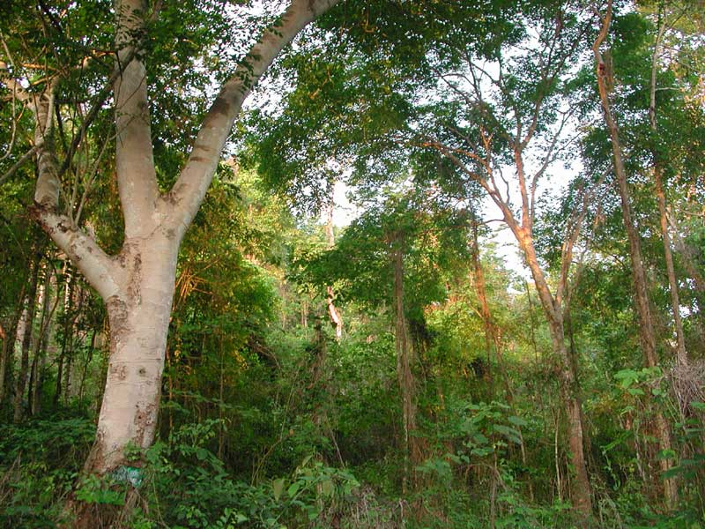
Tropical Dry Deciduous forest in India
Rainfall about 75-100 cm
Shed their leaves in dry season
Transition type- between
Wetter -> moist deciduous
Drier ->tropical thorn

Slide 15
Moist
deciduous
Dry Deciduous
Tropical Thorn
Tropical Moist
Tropical Dry
Tropical Dry

Slide 16
Tropical Dry Deciduous forest in India
Central India
MP, RJ, Kathiawar, western Ghats
Sal, Teak, Rosewood

Slide 17
Tropical Thorn forest in India
Less than 75 cm rainfall
North-west part of the country
RJ, Kutchh, Kathiawar

Slide 18
Vegetation types in India
Tropical forest
Montane forest
Alpine forest

Slide 19
Montane
forest
Sub-tropical forest
(1000-2000m)
Temperate forest
(1500-3000m)

Slide 20
Montane Sub-tropical forest
1000-2000m
Sub-tropical broad-leaves
Subtropical moist Pine
Sub-tropical dry evergreen

Slide 21
Rainfall Decrease from bottom to top
Sub-Tropical Dry-Evergreen
Sub-Tropical Moist Pine
Sub-Tropical Broad leaved

Slide 22
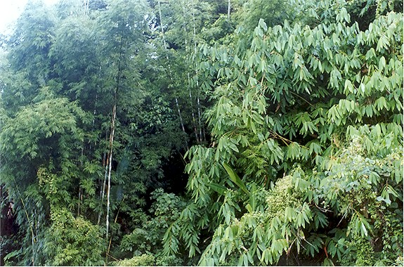
Sub-tropical broad leaved forest
Height 1000-2000m
Rainfall: 75-125 cm
Evergreen dense
Oak, Chestnut

Slide 23
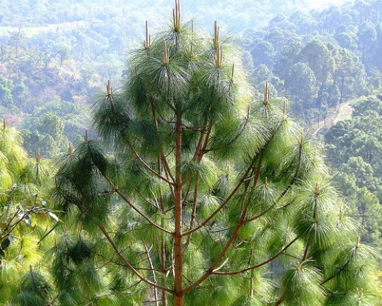
Sub-tropical Moist Pine forest
Height 1000-2000m
But Rainfall: about 100 cm
Eastern Himalayas
Chil/chir most abundant
Chil/Chir is used for timber, resin and turpentine

Slide 24
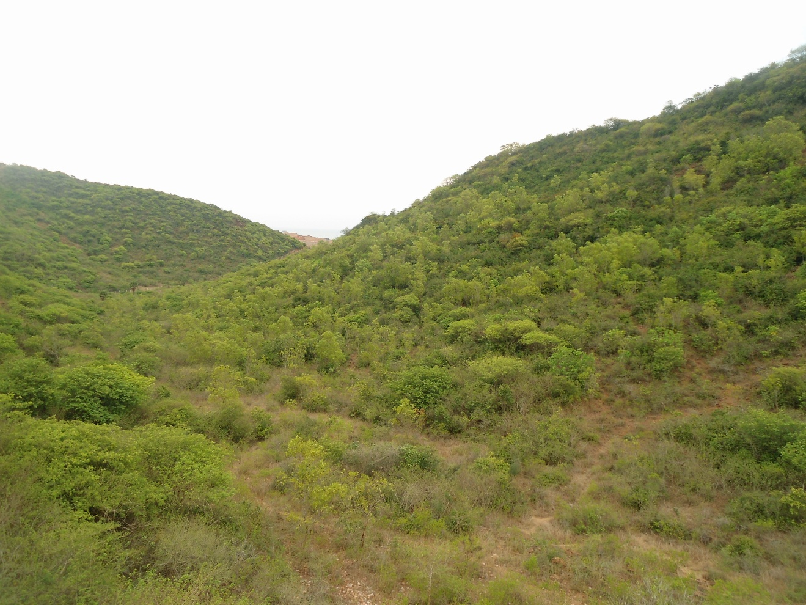
Sub-tropical Dry evergreen forest
Height about 1000
Rainfall: 50-100 cm
Bhabhar, Shiwaliks – western Himalayas
Stunted trees and shrubs

Slide 25
Montane Temperate forest
1500-3000m
Wet-Temperate
Moist-Temperate
Dry-temperate

Slide 26
Rainfall Decrease from bottom to top
Dry-Temperate
Moist-Temperate
Wet-Temperate

Slide 27
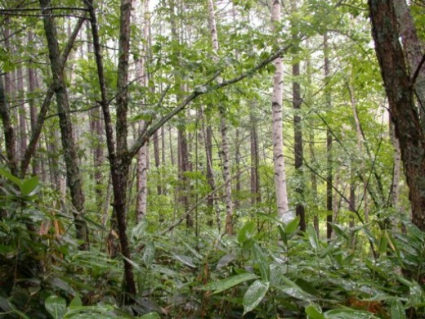
Montane Wet Temperate forest
Height: 1800-3000 m
Rainfall 150-300 cm
Eastern Himalayas
Western Ghats above height of 1800 m
Trees: evergreen, short, leaves dense and round
Deodar, Birch, Plum

Slide 28
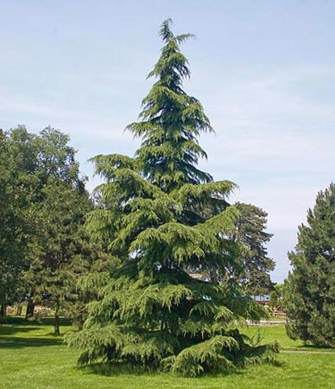
Montane Moist Temperate forest
Height: 1500-3300 m
Rainfall: 150-250 cm
Entire length of Himalayas
Deodar dominates
Deodar wood used for Timber, railway sleepers

Slide 29
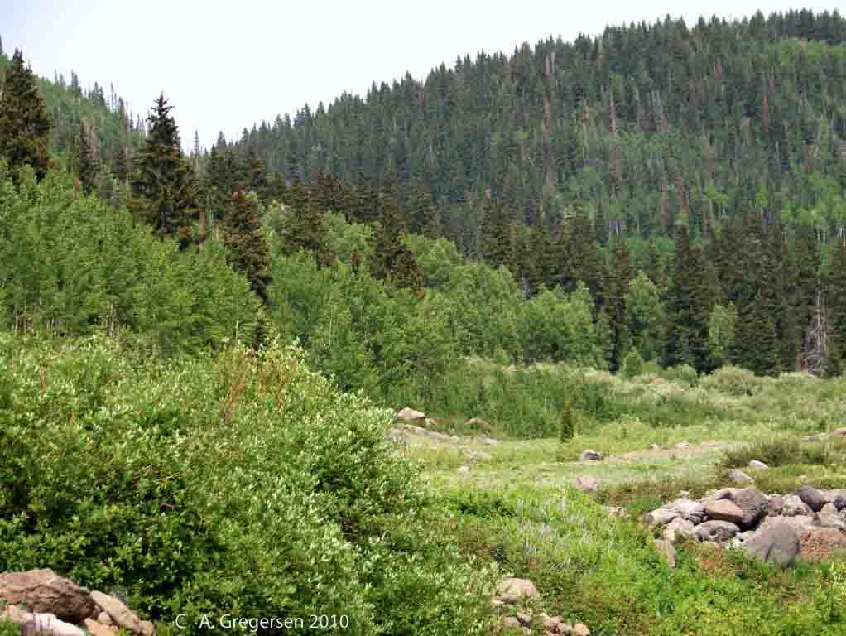
Montane Dry Temperate forest
Rainfall: less than 100 cm
Dry part of Himalayas
Ladakh, Sikkim and Garhwal
Coniferous forest
Oak, ash, maple

Slide 30
Vegetation types in India
Tropical forest
Montane forest
Alpine forest

Slide 31
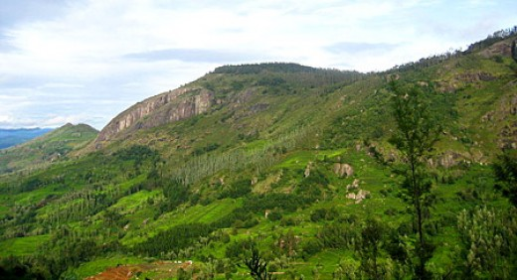
Alpine forest
Height: 2900- 3800 m
Mixture of coniferous trees, large scrubs, broad-leaved trees
Then with increase in height - Alpine grass a and scrub
Fur, Spruce, Birch, Berberries

Slide 32
Vegetation types in India
Tropical forest
Montane forest
Alpine forest

Slide 33
Forest type - Area
Forest type | Percentage of total area
Tropical Moist Deciduous forest (100-200 cm) | 37%
Tropical Dry Deciduous forest (~100cm) | 28%
Tropical Wet Evergreen (>250cm) | 8%
Montane Sub-Tropical Pine (Chir) | 6.6%
Tropical Semi-Evergreen | 4%

Slide 34
Forest type - Area
Forest type | Percentage of total area
Montane Wet Temperate | 3.6%
Montane Moist Temperate (Deodar) | 3.4%
Sub-tropical Dry Evergreen (shiwaliks) | 2.5%
Alpine | 2.1%

Slide 35
Forest type - Area
Forest type | Percentage of total area
Littoral-swamp | 0.6%
Sub-tropical Broad leaved | 0.4%
Montane Dry Temperate | 0.3%
Tropical Dry Evergreen | 0.2%

Slide 36
UPSC
Question
Q. In India, which type of forest among the following occupies the largest area?
Montane wet forest
Sub-tropical dry evergreen
Tropical moist deciduous forest
Tropical wet evergreen forest
Prelims
2010

Slide 37
UPSC
Question
Montane wet forest -3.6%
Sub-tropical dry evergreen – 2.5%
Tropical moist deciduous forest – 37%
Tropical wet evergreen forest – 8%
Ans. C)
Prelims
2010

